Slide 1
Accounting and Financial Reporting Chapter 3
Note that you will need to view the slides in presentation view to remove the white boxes that cover the answers.

Slide 2
Learning Objectives
After studying Chapter 3, you should be able to:
Explain the accrual basis of accounting and apply the revenue and expense recognition principles to measure income.
Apply transaction analysis to examine and record the effects of operating activities on the financial statements.
Prepare a classified income statement.

Slide 3
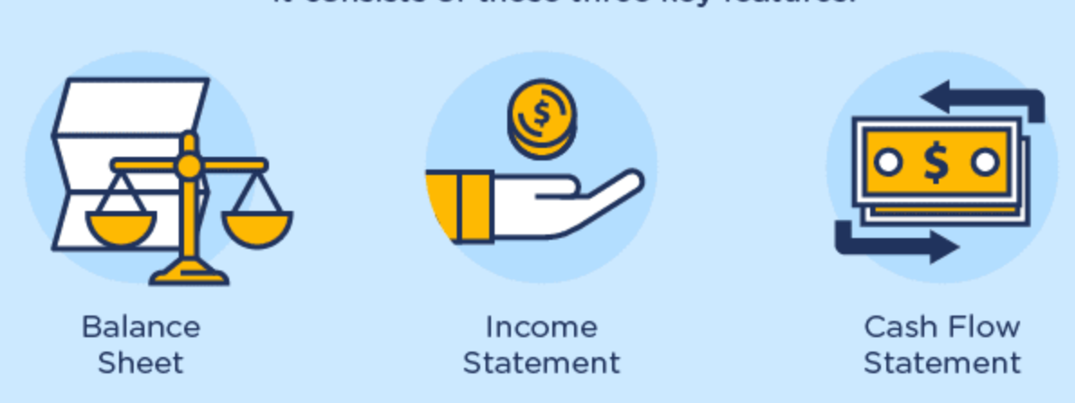
Review: Financial Statements
A set of organizational tools that tell the story of what happened over the last period of time and where the entity stands today.
Graphics Source: www.visualcapitalist.com

Slide 4
A statement that tells us what we own, what we owe, and the difference between those two things as of a single point in time.
A statement that tells us how much revenue we generated and how much expense we incurred over a period of time.
Assets = Liabilities + Shareholders’ Equity
(Basic Accounting Equation)
Revenues – Expenses = Net Income
Graphics Source: www.visualcapitalist.com

Slide 5
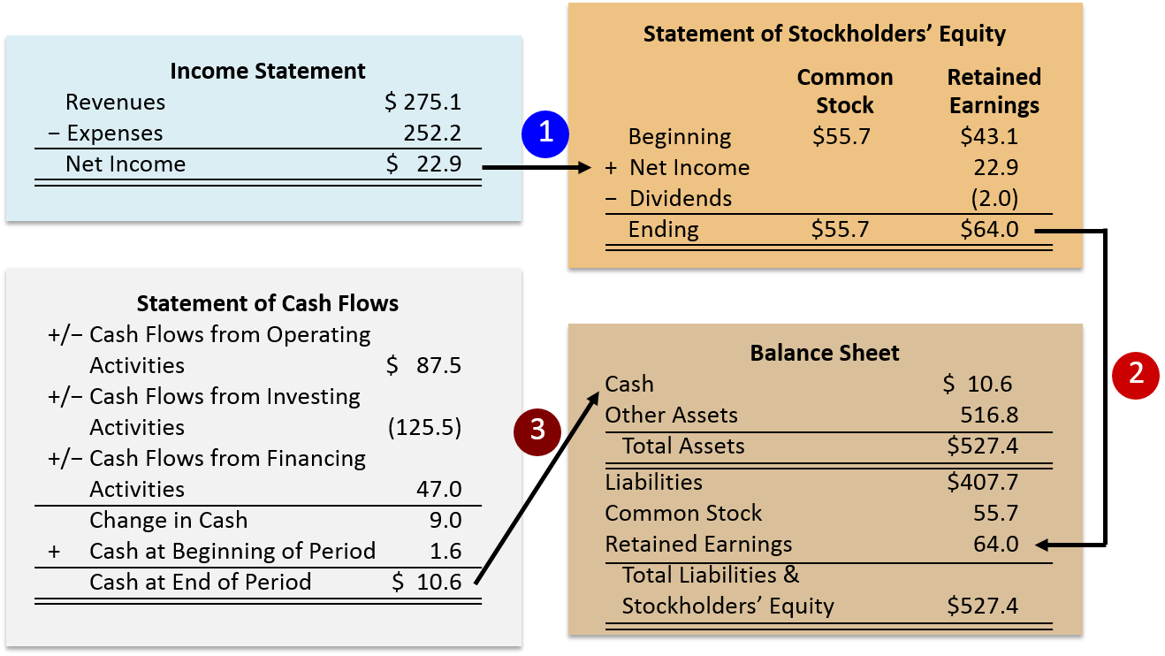
Review: Relationship Among Statements Articulation

Slide 6
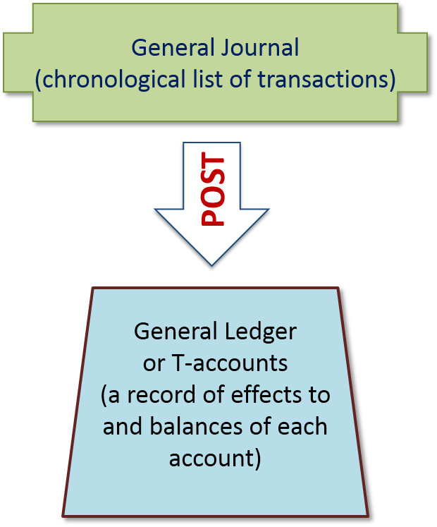
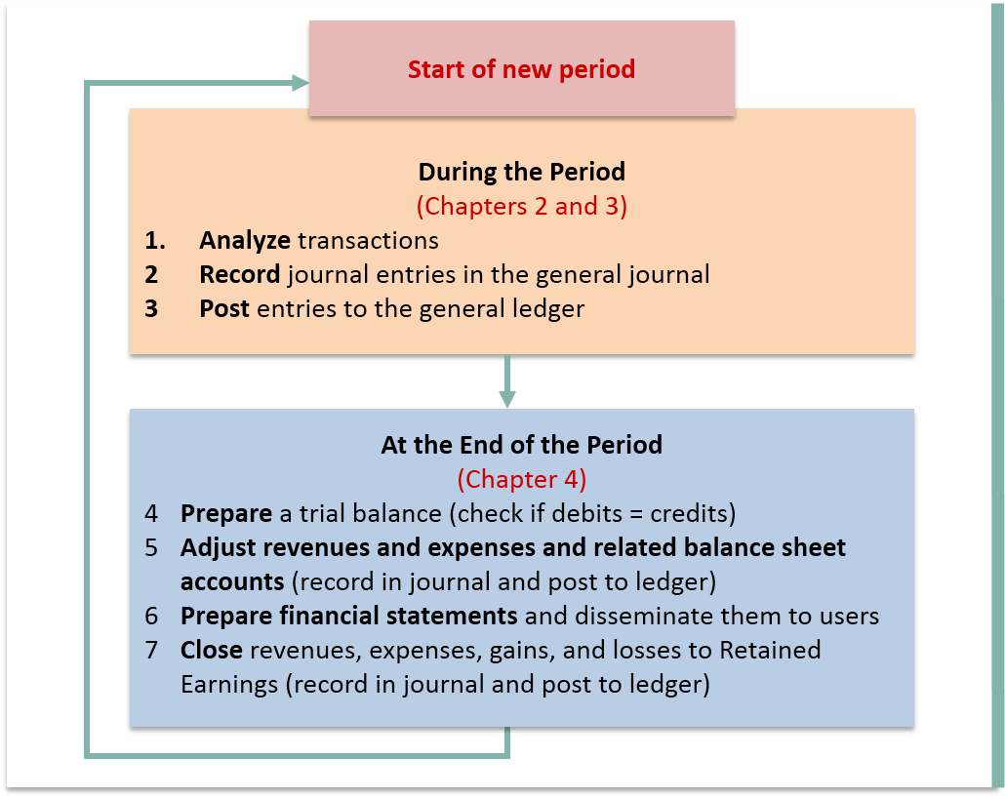
Review: Flow of Work in the Accounting Cycle

Slide 7
Elements of the Income Statement
Revenues
Increases in assets or settlements of liabilities from the major or central ongoing operations.
Expenses
Decreases in assets or increases in liabilities from ongoing operations incurred to generate revenues.
Gains
Increases in assets or settlements of liabilities from peripheral transactions.
Losses
Decreases in assets or increases in liabilities from peripheral transactions.

Slide 8
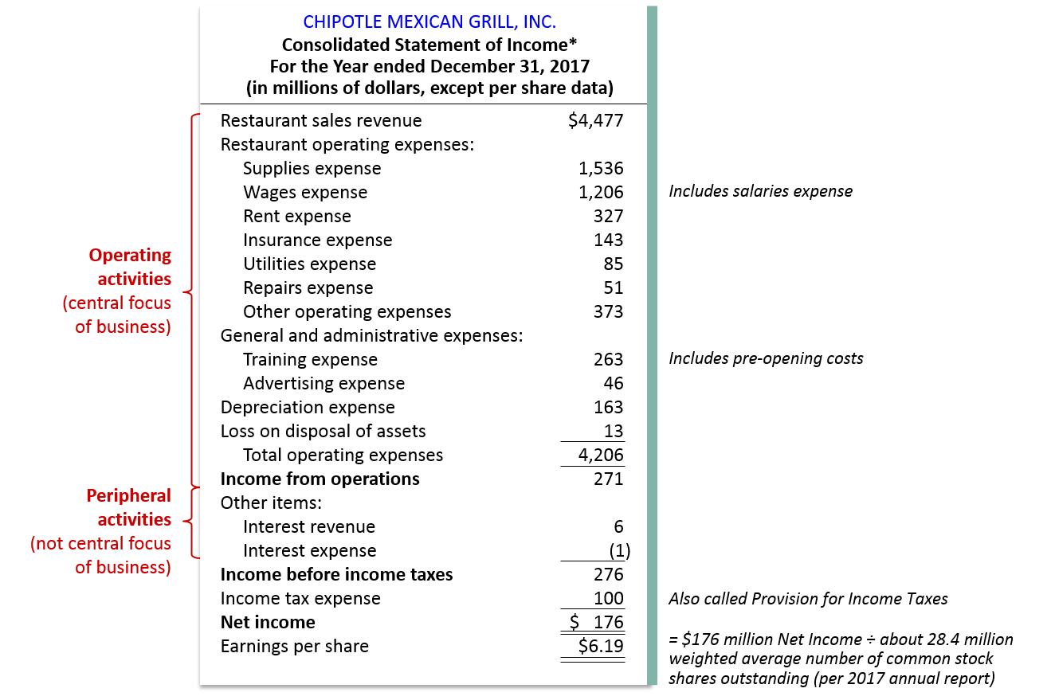
Chipotle’s Income Statement

Slide 9
Revenue Recognition
Revenue is the amount of cash, or the cash-equivalent value of non-cash assets received from customers.
A firm recognizes revenue when a transaction meets two primary conditions:
The seller has delivered all of the goods and services it has agreed to provide (revenue has been earned)
The seller has received cash or some other asset that it can convert to cash (revenue has been realized or is realizable)

Slide 10
Revenue Recognition
Revenues are distinguished from gains
A gain increases net assets and increases income, but it is not a transaction with a customer that is part of core operations
Common source of a gain is when selling a fixed asset (like a building or a piece of equipment).

Slide 11
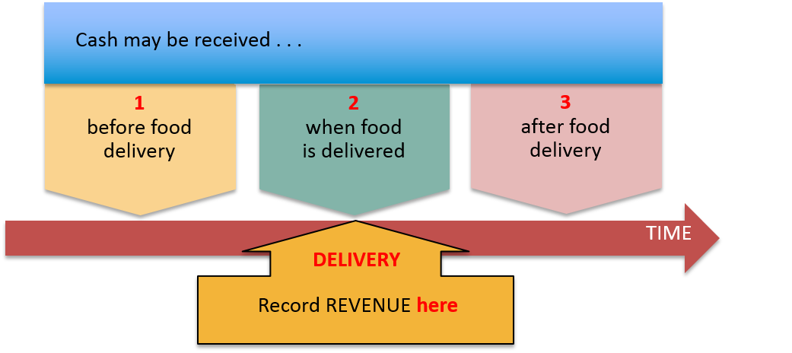
Timing of Revenue Recognition for Chipotle

Slide 12

What if I get cash before I deliver the goods?
If cash is received before the company delivers goods or services, the liability account UNEARNED REVENUE is recorded.
On receipt of a $100 cash deposit: | Debit | Credit
Cash (+A) | 100
Unearned Revenue (+L) |  | 100
On delivery of ordered food: | Debit | Credit
Unearned Revenue (−L) | 100
Restaurant Sales Revenue (+R, +SE) |  | 100

Slide 13
What if I get cash when I deliver the goods?
When cash is received in the same period as the goods or services are delivered.
On delivery of ordered food for $12 cash: | Debit | Credit
Cash (+A) | 12
Restaurant Sales Revenue (+R, +SE) |  | 12

Slide 14
What if I get cash after I deliver the goods?
If cash is received after the company delivers goods or services, an asset ACCOUNTS RECEIVABLE is recorded.
On delivery of ordered food for $50 on account: | Debit | Credit
Accounts Receivable (+A) | 50
Restaurant Sales Revenue (+R, +SE) |  | 50
On receipt of cash after delivery: | Debit | Credit
Cash (+A) | 50
Accounts Receivable (−A) |  | 50

Slide 15
Expense Recognition
Expense recognition focuses on when the firm consumes the benefits
This is called the “Matching Principle.”
The firm recognizes an expense when:
Consumption results from a transaction that leads to the recognition of revenue, or
Example: consumption of gasoline used to power the lawn mower used in your lawn mowing business
Consumption from the passage of time
Example: interest expense that is accrued on a loan over time

Slide 16
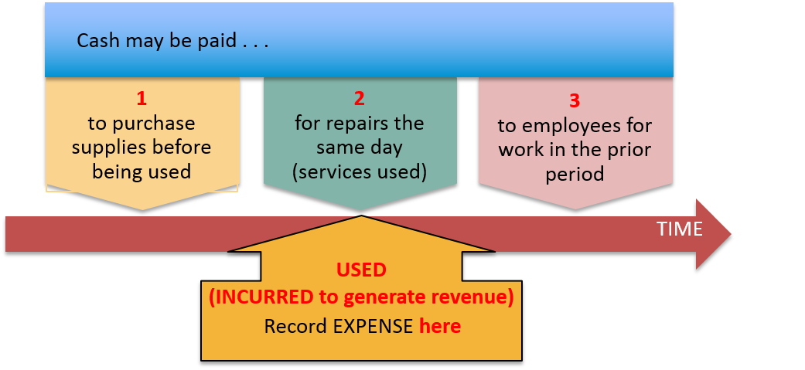
Timing of Expense Recognition for Chipotle

Slide 17
What if I pay cash before the expense is incurred?
Cash is paid before the expense is incurred to generate revenue.
On payment of $200 cash for supplies: | Debit | Credit
Supplies (+A) | 200
Cash (−A) |  | 200
On subsequent use of half of the supplies: | Debit | Credit
Supplies Expense (+E, −SE) | 100
Supplies (−A) |  | 100

Slide 18
What if I pay cash when the expense is incurred?
Cash is paid in the same period as the expense is incurred to generate revenue.
On payment of $275 cash for using repair service | Debit | Credit
Repairs Expense (+E, −SE) | 275
Cash (−A) |  | 275

Slide 19
What if I pay cash after the expense is incurred?
Cash is paid after the expense is incurred to generate revenue.
On the use of $400 in employees’ services during the period: | Debit | Credit
Wages Expense (+E, −SE) | 400
Wages Payable (+L) |  | 400
On payment of cash after using employees: | Debit | Credit
Wages Payable (−L) | 400
Cash (−A) |  | 400

Slide 20
Do not make this harder than it is!
As it relates to revenue, ask yourself:
Has the revenue been earned? As in, have I done whatever it is that I am in the business of doing? Have I mowed the lawn? Have I delivered the t-shirts? Have I performed the surgery?
Is this a recurring event? If so, this is core operations and should be called revenue.
Has the revenue been realized? As in, do I have the cash in my hands right now?
If it has not yet been realized, is it realizable? As in, do I have reasonable assurance that the entity that owes me money will eventually pay me?

Slide 21
Do not make this harder than it is!
As it relates to expenses, ask yourself:
When did I record the revenue to which this expense is related?
You will record the expense in the same period that you record the revenue that those expenses were used to help generate.
Expenses follow revenue so you CANNOT know when you should record an expense until you know when you recorded the associated revenue.

Slide 22
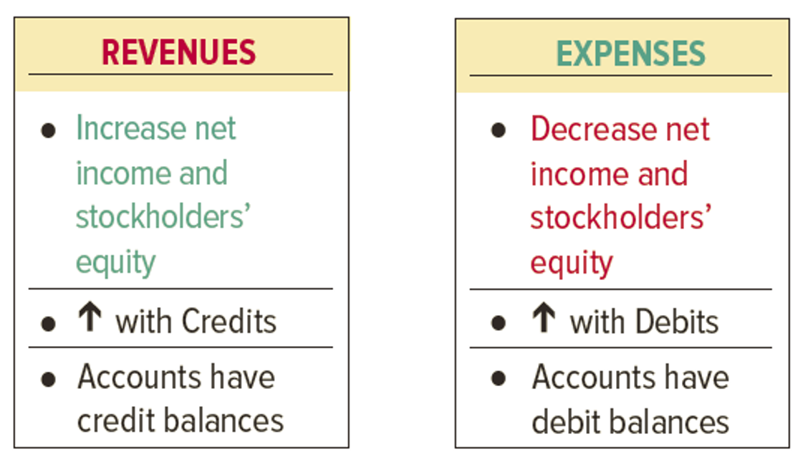
Summary

Slide 23
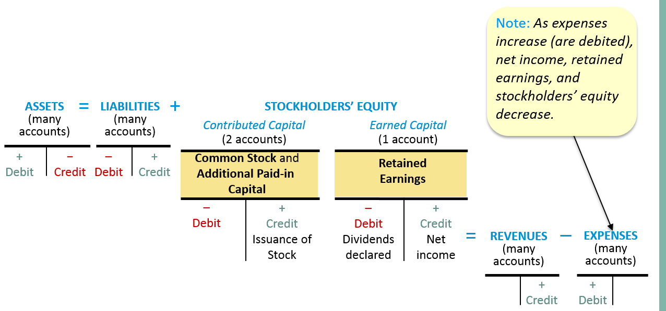
Review: Transaction Analysis
Note: Instead of reducing Retained Earnings directly when dividends are declared, companies may use the account Dividends Declared, which has a debit balance.

Slide 24
Steps in Analyzing Transactions
What accounts (and account types) are involved in the transaction?
Cash, Common Stock, Sales Revenue, etc.
Remember: At least two accounts will be involved
Does the account increase or decrease?
How do I make this kind of account move in that direction?
Assets increase with a debit and decrease with a credit.
Liabilities and Equity accounts increase with a credit and decrease with a debit.
Revenue is recorded with a credit.
Expense is recorded with a debit.

Slide 25
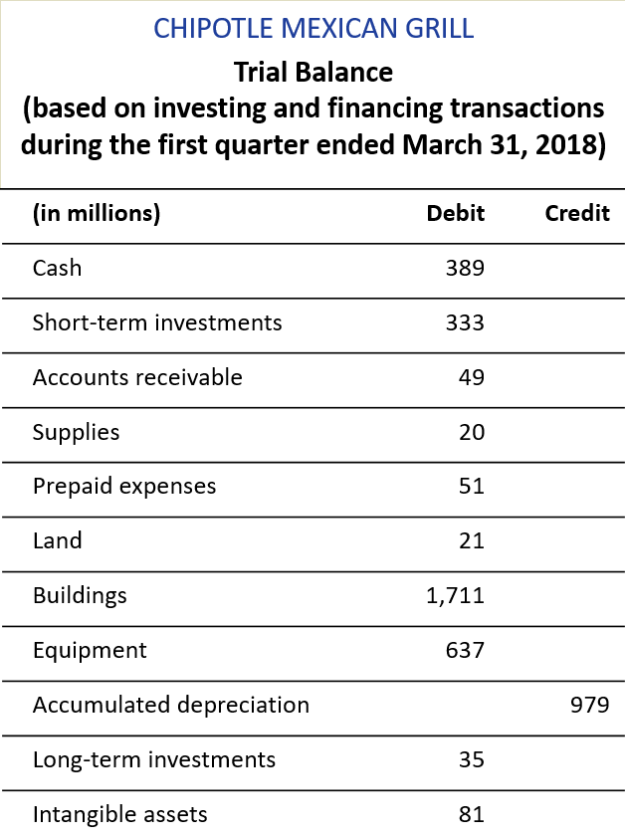
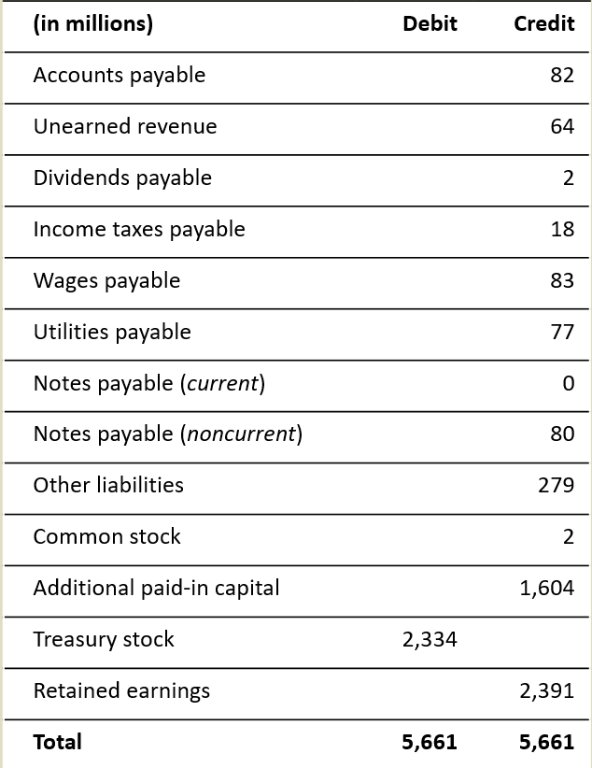
Let’s Practice Chipotle’s Trial Balance

Slide 26
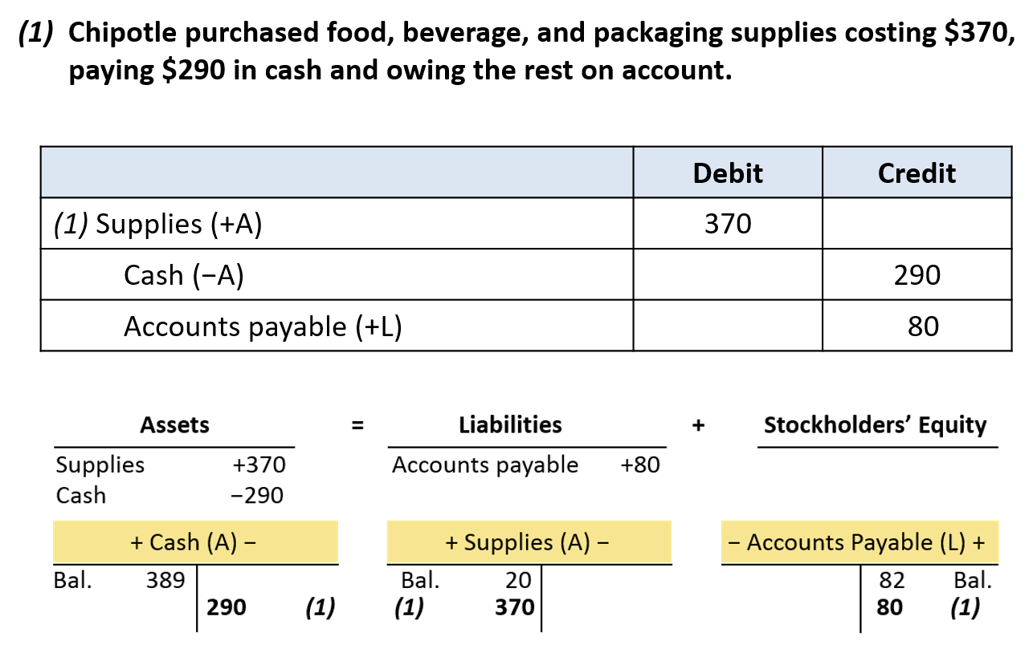
Let’s Practice Chipotle

Slide 27
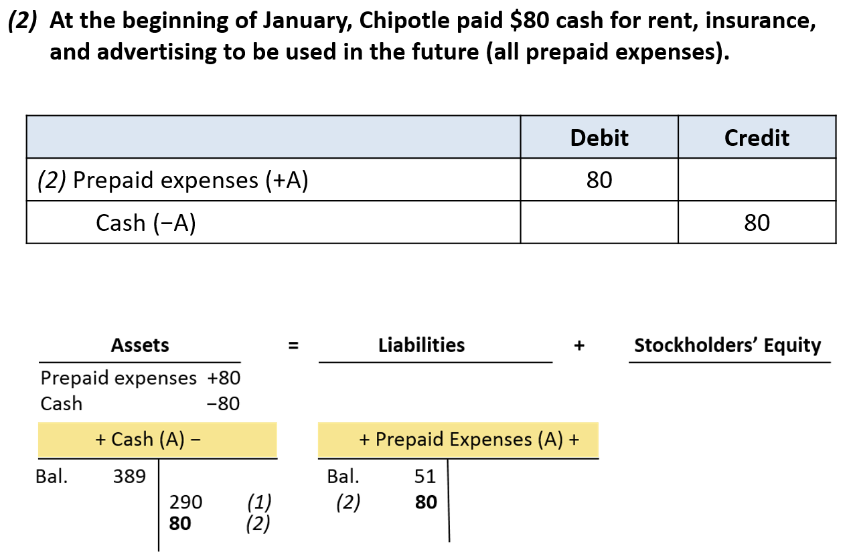
Let’s Practice Chipotle

Slide 28
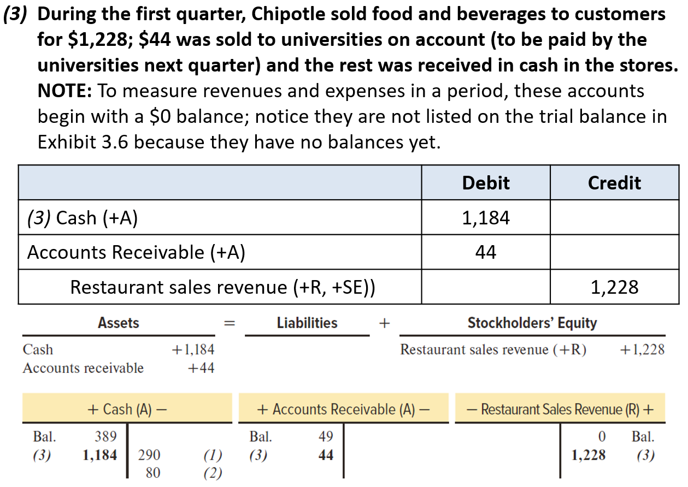
Let’s Practice Chipotle

Slide 29
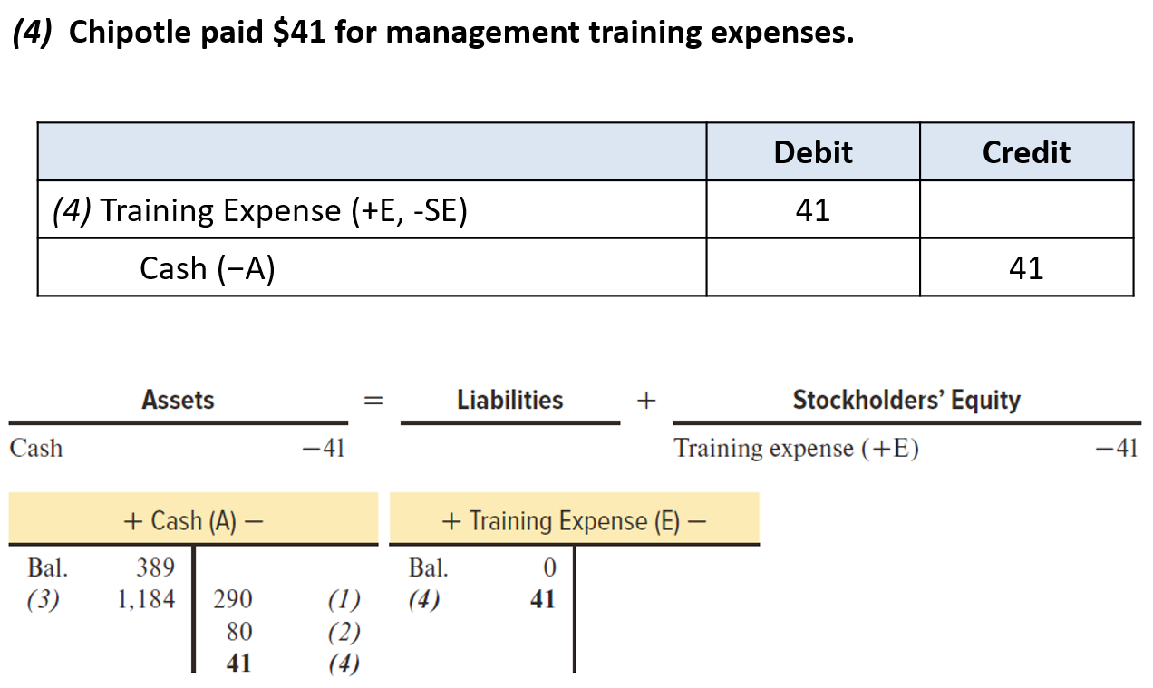
Let’s Practice Chipotle

Slide 30
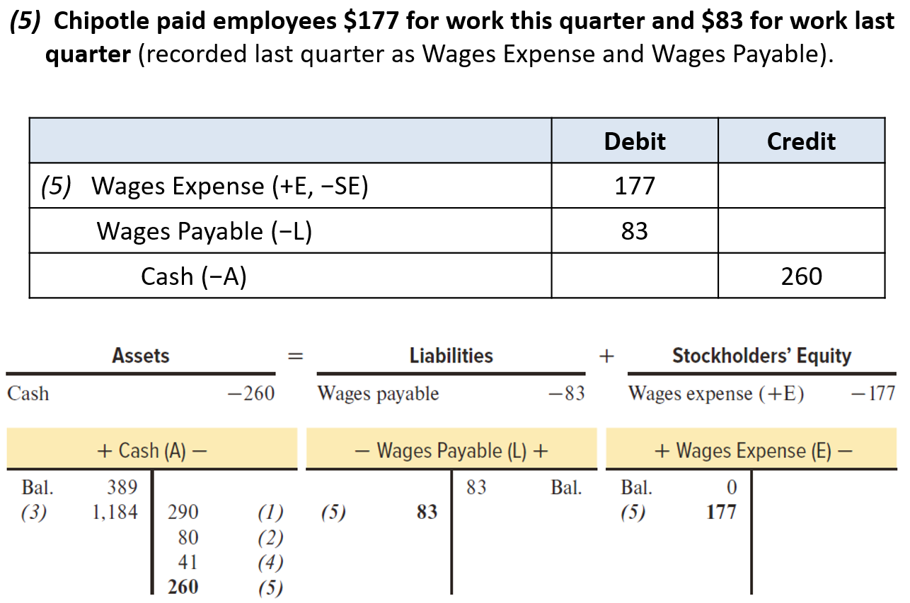
Let’s Practice Chipotle

Slide 31
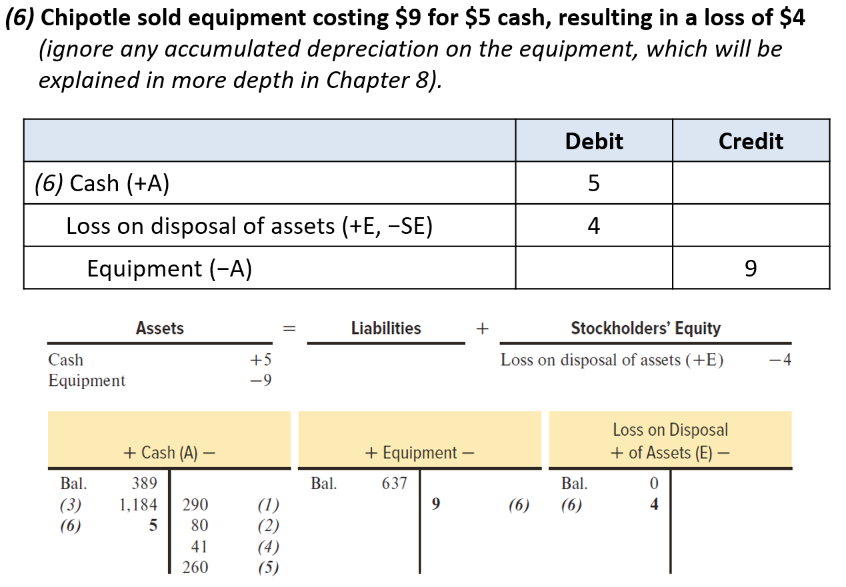
Let’s Practice Chipotle

Slide 32
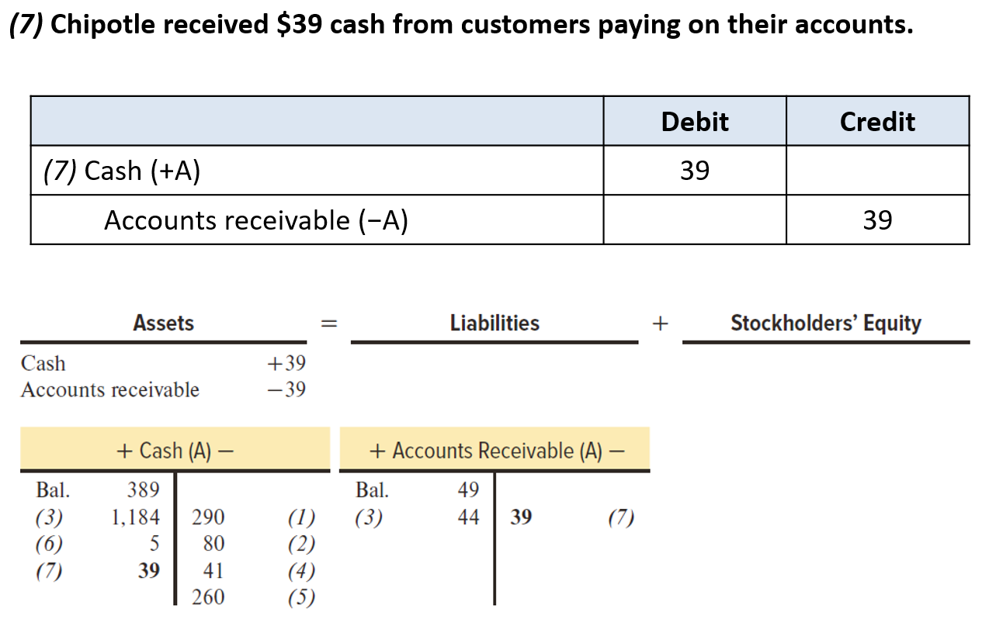
Let’s Practice Chipotle

Slide 33
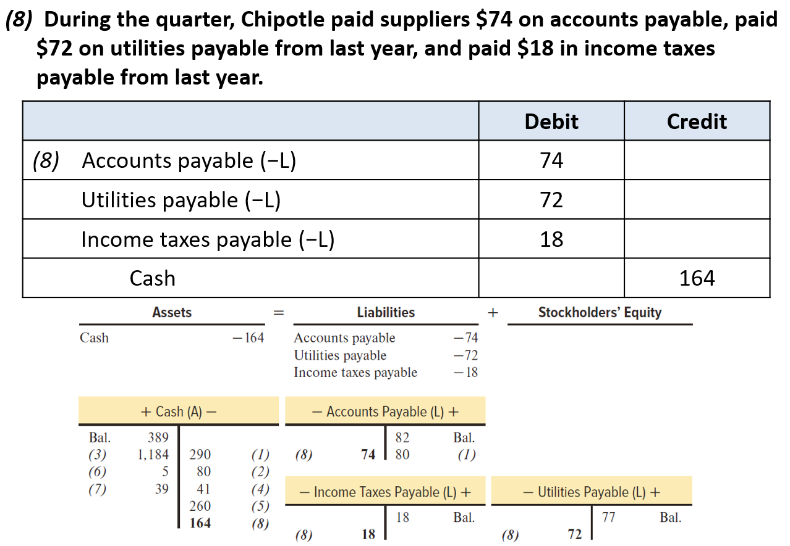
Let’s Practice Chipotle

Slide 34
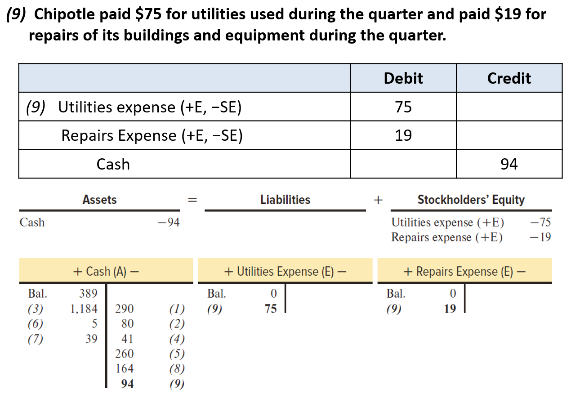
Let’s Practice Chipotle

Slide 35
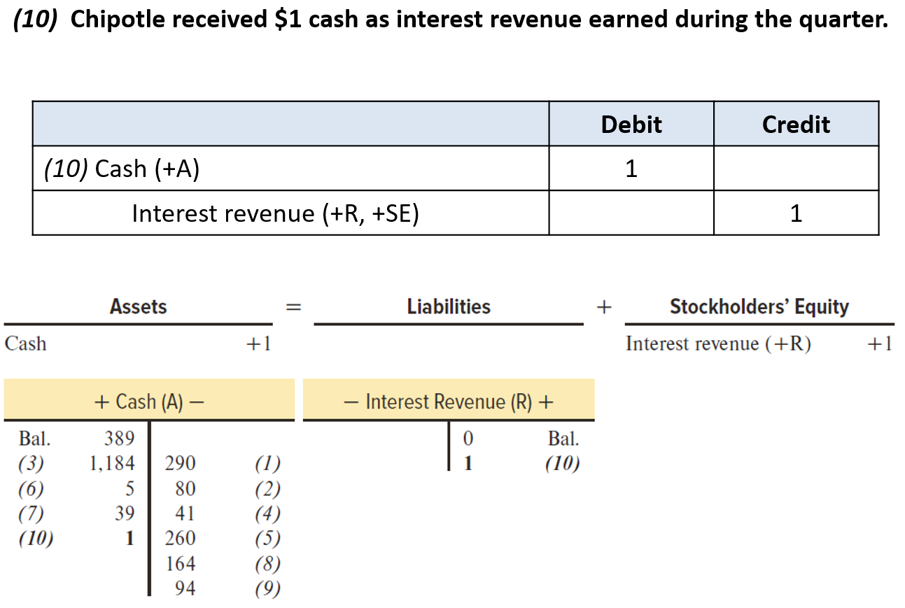
Let’s Practice Chipotle

Slide 36
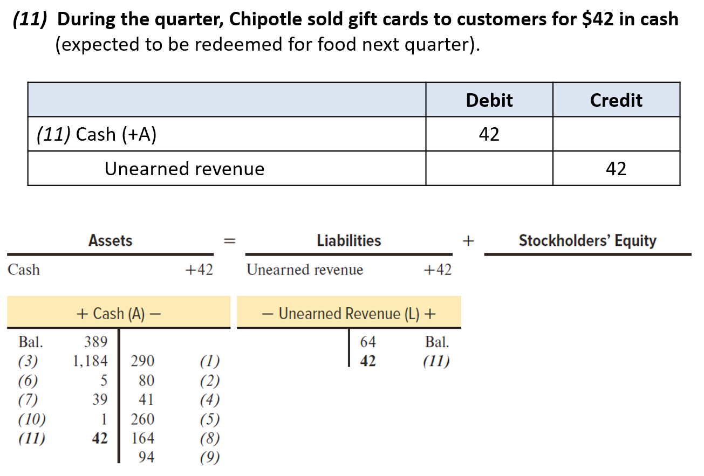
Let’s Practice Chipotle

